Slide 1
BULLYING
This week’s topic

Slide 2
HAVE YOU EVER SEEN
BULLYING?
YES
NO

Slide 3
WHAT IS BULLYING?
Bullying involves repeated aggressive behavior that is intended to hurt or intimidate another person physically, verbally, or psychologically. Bullying can occur in person, online (cyberbullying), and in a variety of settings, including schools, workplaces, and social spaces.

Slide 4
TYPES OF BULLYING
Physical Bullying
Verbal Bullying
Hitting, pushing, or other physical aggression.
Name calling, insults, and other forms of derogatory language.
Cyberbullying
Social Bullying
Using digital platforms to repeatedly harass or humiliate someone.
Spreading rumors, excluding others, and public embarrassment.

Slide 5
WHAT ARE SOME ACTIONS OF
BULLYING
Tease – to make fun of someone in a hurtful way
Hit – to hurt someone physically with your hand or an object
Push – to force someone with your hands or body
Kick – to hit someone using your foot
Threaten – to say you will hurt someone to make them scared
Insult – to say mean or rude things
Mock – to copy someone to make fun of them
Ignore – to leave someone out on purpose
Spread rumors – to tell lies or gossip about someone
Cyberbully – to bully someone online or through messages

Slide 6
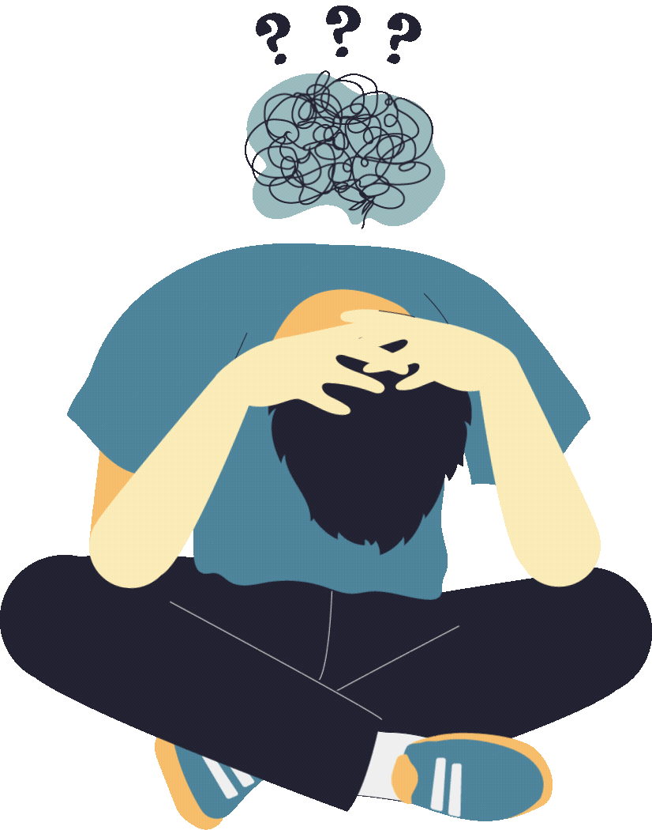
Who is...?
VICTIM
BYSTANDER
BULLY

Slide 7
IMPACT OF BULLYING
Bullying can have a major impact on both victims and perpetrators:
VICTIM
Increased risk of depression, anxiety, difficulty sleeping, decreased academic performance, and in severe cases, suicidal thoughts.
BULLY
Higher risk for academic problems, and violent behavior later in life.
BYSTANDER
Leading to guilt, stress, and fear. It may cause emotional numbness over time and damage one’s self-esteem.

Slide 8
How do the victim feel when being
Bullying?
Scared – feeling afraid or frightened
Lonely – feeling alone or without support
Embarrassed – feeling ashamed or uncomfortable
Sad – feeling unhappy or down
Helpless – feeling like you can’t do anything to stop it
Worried – feeling nervous about what might happen
Angry – feeling mad or upset
Confused – not understanding why it’s happening
Rejected – feeling left out or unwanted
Hopeless – feeling like things won’t get better

Slide 9
RECOGNIZING THE SIGNS OF BULLYING
It's crucial to recognize the signs of bullying:
Withdrawal from social interaction
Changes in mood, behavior, sleep, or appetite
Avoidance of certain situations, such as refusing to go to school
Unexplained injury or loss of property

Slide 10
PREVENTIVE MEASURE
It's crucial to recognize the signs of bullying:
EDUCATION
Teach empathy and respect from an early age.
POLICY
Set clear rules and consequences regarding bullying.
OPEN COMMUNICATION
Create a safe environment where children and adults feel comfortable reporting bullying.

Slide 11
SPEAKING TIME
“What happened?” “How did the person feel?”
“What would you do if you saw someone being bullied?”
“Why do people bully others?”
“What can schools do?”

Slide 12
By coming together, educating ourselves and our communities, and taking proactive steps, we can combat bullying and create a safer environment for everyone.

Slide 13
Let’s be the change we want to see in the world!

Slide 14
THANK YOU

